Slide 1
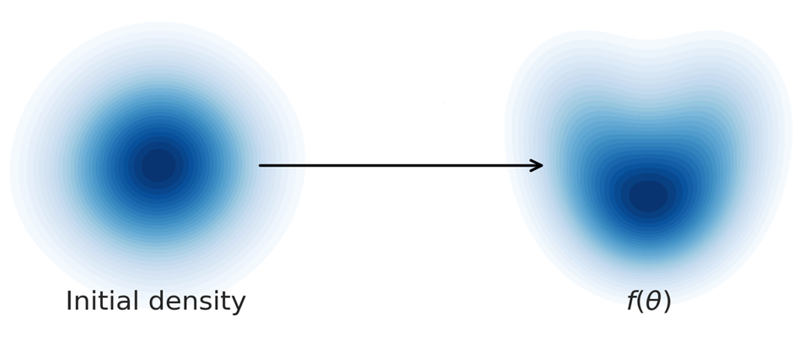
Mixture Flows
Ruqi Bai
Purdue University
Code available: https://github.com/RuqiBai/mixture_flow
The figure is from https://astroautomata.com/blog/simulation-based-inference/
Notes:
Hello everyone, today I am going to share a paper with you called normalizing flows for probabilistic modeling and inference. It is a review paper published in 2019. it thoroughly covers the topic in normalizing flows. We get only 25 minutes. So, I will only be able to share some basic ideas with you. If you want more detail, it is worth taking some time to read this paper.

Slide 2
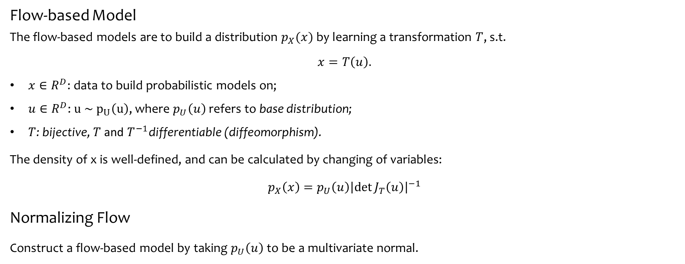
Normalizing Flows
Flow-based Model
The flow-based models are to build a distribution $p_{X}(x)$ by learning a transformation $T$, s.t.
$$x=T\left(u\right).$$
$x∈R^{D}$: data to build probabilistic models on;
$u∈R^{D}$: $u \sim p_{U}\left(u\right)$, where $p_{U}\left(u\right)$ refers to base distribution;
$T$: bijective, $T$ and $T^{−1}$differentiable (diffeomorphism).
The density of x is well-defined, and can be calculated by changing of variables:
$$p_{X}\left(x\right)=p_{U}\left(u\right){\left|\det{J_{T}\left(u\right)}\right|}^{−1}$$
Normalizing Flow
Construct a flow-based model by taking $p_{U}\left(u\right)$ to be a multivariate normal.
Notes:
Okay, so, the first question. What is normalizing flows. Basically, it tries to build a probabilistic distribution on the dataset, like, for example, images, videos, speech. The underlying distribution of those dataset are often extremely complex. The classic methods like models with hidden variables couldn’t approximate the underlying distribution well. Normalizing flows are powerful tools for these tasks.
So, the basic idea of flows are to learn a transformation T, where x equals to T of u. X are the data to build probabilistic models on. And u are sampled from our known data distribution p of U. This transformation could link our data distribution to a distribution that we can handle. Transformation T should be bijective. T and T inverse are differentiable. By the way, the combination of these properties are called diffeomorphism. Then, our x and u are linked by T. and if we use change of variables, we could connect the distribution of x and u. In practice, we want the base distribution p_U easy to handle. We often choose normal distribution. And this is normalizing flow. Why T needs to be diffeomorphism? I will talk about it later. Basically, suppose you want to sample from your data distribution p_X, you can not sample directly from this distribution, right? But you can sample a new u. and transfer it to x. This need every u has exact one corresponding x. When you want to evaluate the probability of an unknown sample, x’, you need to transform it to u’, this need every x has exact one u. And during the learning phase, you want to minimize some divergence by gradient based algorithm, so you need T to be differentiable. Okay, quite straight forward. right?

Slide 3
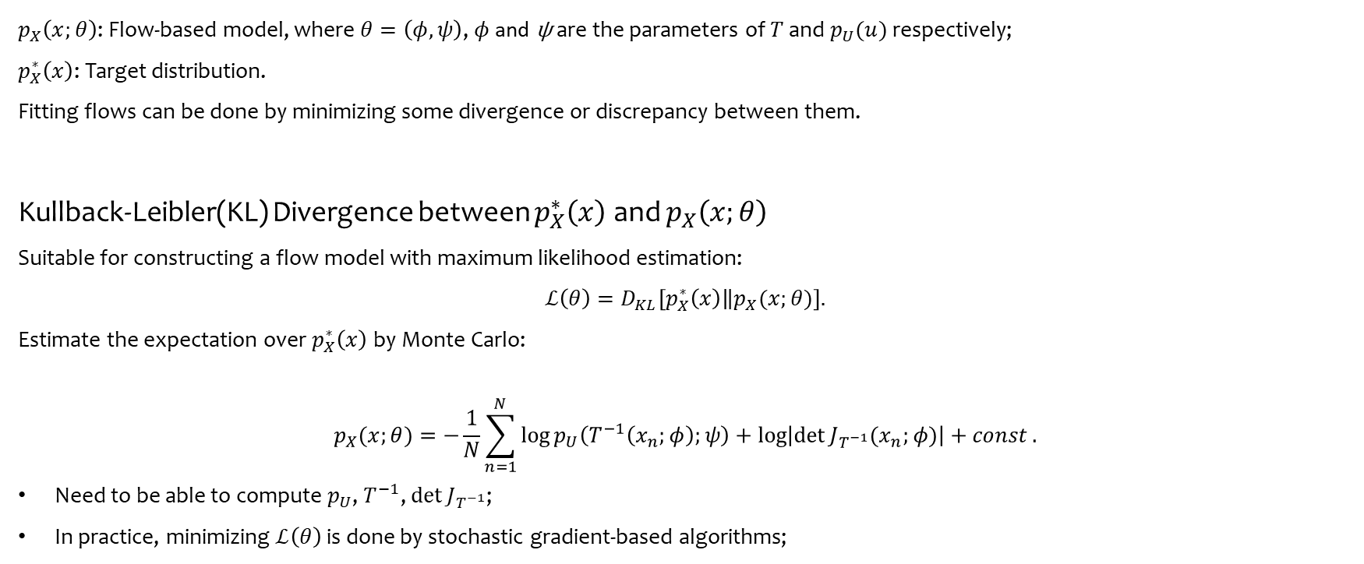
Normalizing Flows
$p_{X}\left(x;θ\right)$: Flow-based model, where $θ=\left(φ,ψ\right)$, $φ$ and ψ are the parameters of $T$ and $p_{U}(u)$ respectively;
$p_{X}^{∗}\left(x\right)$: Target distribution.
Fitting flows can be done by minimizing some divergence or discrepancy between them.
Kullback-Leibler(KL) Divergence between $p_{X}^{∗}\left(x\right)$ and $p_{X}\left(x;θ\right)$
Suitable for constructing a flow model with maximum likelihood estimation:
$$ℒ\left(θ\right)=D_{KL}\left[p_{X}^{∗}\left(x\right)\left\|p_{X}(x;θ)\right.\right].$$
Estimate the expectation over $p_{X}^{∗}\left(x\right)$by Monte Carlo:
$$p_{X}(x;θ)=−\frac{1}{N}\sum_{n=1}^{N}{\log{p_{U}\left(T^{−1}\left(x_{n};φ\right);ψ\right)+\log\left|\det{J_{T^{−1}}(x_{n};φ)}\right|+const.}}$$
Need to be able to compute $p_{U}$, $T^{−1}$, $\det{J_{T^{−1}}}$;
In practice, minimizing $ℒ\left(θ\right)$ is done by stochastic gradient-based algorithms;

Slide 4
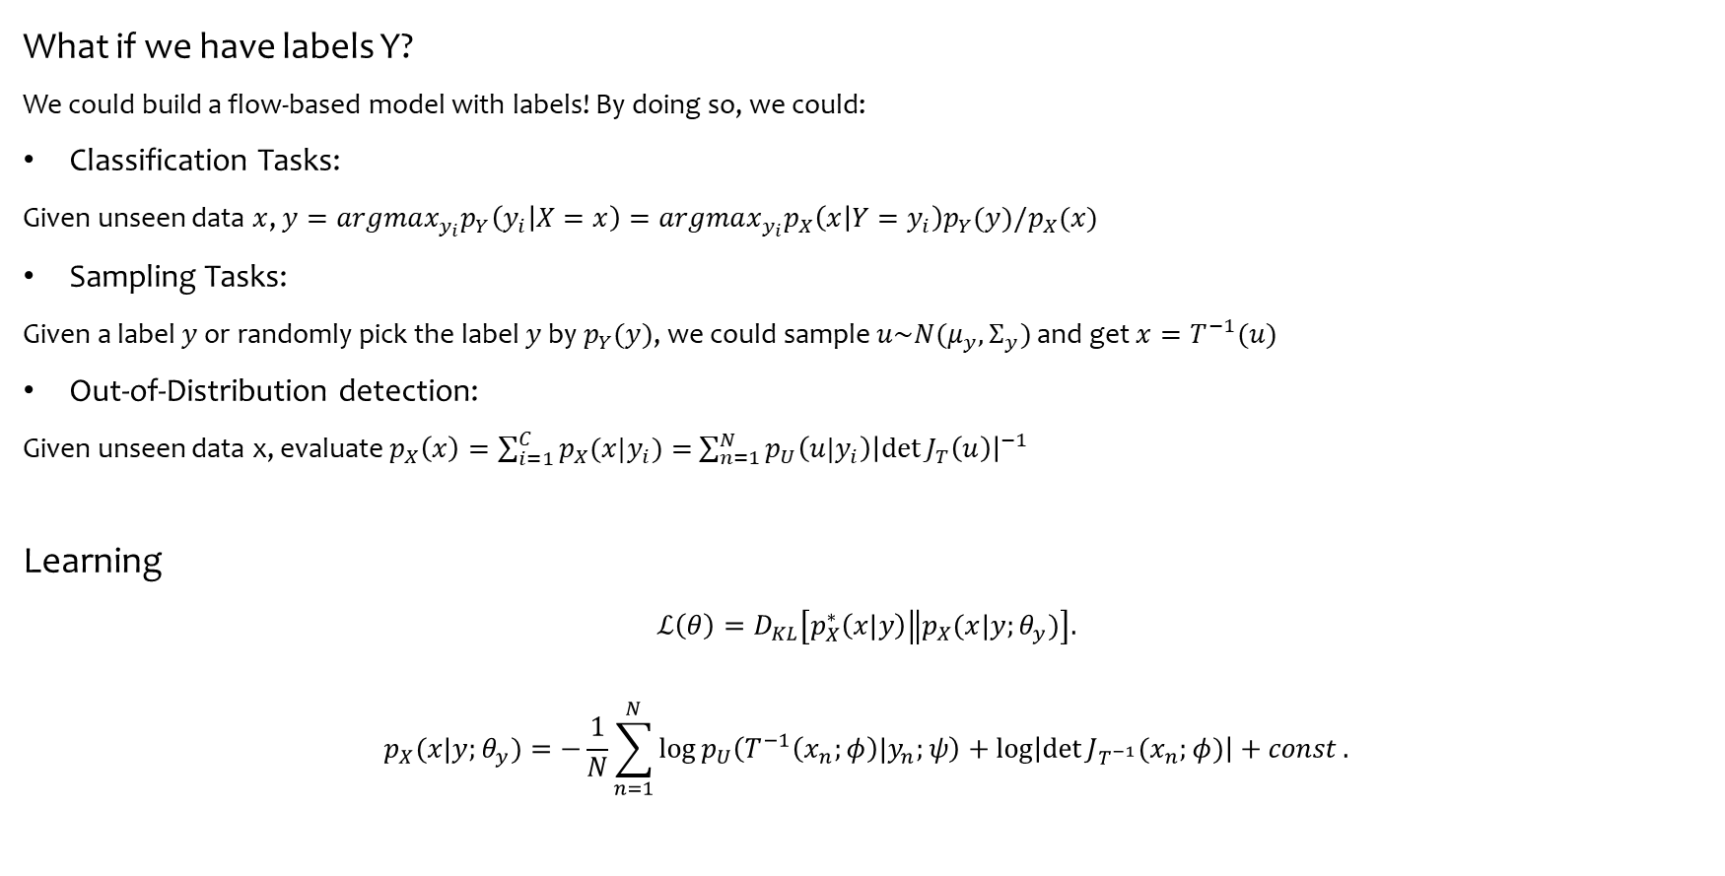
Mixture Normalizing Flows
What if we have labels Y?
We could build a flow-based model with labels! By doing so, we could:
Classification Tasks:
Given unseen data $x$, $y=argmax_{y_{i}}p_{Y}\left(y_{i} | X=x\right)=argmax_{y_{i}}p_{X}\left(x | Y=y_{i}\right)p_{Y}(y)/p_{X}(x)$
Sampling Tasks:
Given a label $y$ or randomly pick the label $y$ by $p_{Y}(y)$, we could sample $u\sim N(μ_{y}, Σ_{y})$ and get $x=T^{−1}(u)$
Out-of-Distribution detection:
Given unseen data x, evaluate $p_{X}\left(x\right)=\sum_{i=1}^{C}{p_{X}(x|y_{i})}=$ $\sum_{n=1}^{N}{p_{U}\left(u|y_{i}\right){\left|\det{J_{T}\left(u\right)}\right|}^{−1}}$
Learning
$$ℒ\left(θ\right)=D_{KL}\left[p_{X}^{∗}\left(x|y\right)\left\|p_{X}(x|y;θ_{y})\right.\right].$$
$$p_{X}(x|y;θ_{y})=−\frac{1}{N}\sum_{n=1}^{N}{\log{p_{U}\left(T^{−1}\left(x_{n};φ\right)|y_{n};ψ\right)+\log\left|\det{J_{T^{−1}}(x_{n};φ)}\right|+const.}}$$
N
X
Y

Slide 5
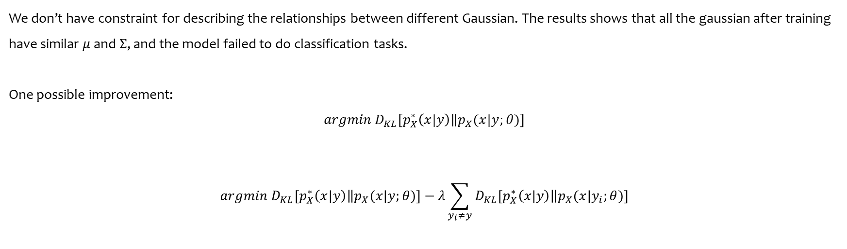
Problem
We don’t have constraint for describing the relationships between different Gaussian. The results shows that all the gaussian after training have similar $μ$ and $Σ$, and the model failed to do classification tasks.
One possible improvement:
$$argmin D_{KL}\left[p_{X}^{∗}\left(x|y\right)\left\|p_{X}(x|y;θ)\right.\right]$$
$$argmin D_{KL}\left[p_{X}^{∗}\left(x|y\right)\left\|p_{X}(x|y;θ)\right.\right]−λ\sum_{y_{i}≠y}{D_{KL}\left[p_{X}^{∗}\left(x|y\right)\left\|p_{X}(x|y_{i};θ)\right.\right]}$$

Slide 6
Q & A

